Slide 1
Digital Image Formation and Enhancement
Report 1
Jerico Miguel Rangel
2018-11666

Slide 2
Objectives
To understand the math behind digitally analyzing and working with images
Create synthetic images using python/matlab
Understand how colors are mathematically represented in code
Restore or enhance images through backprojection, histogram input-output curves, contrast stretching, and white balancing algorithms

Slide 3
Results and Analysis:

Slide 4
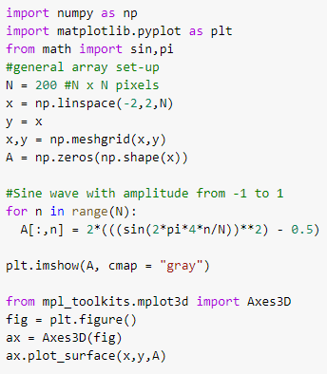
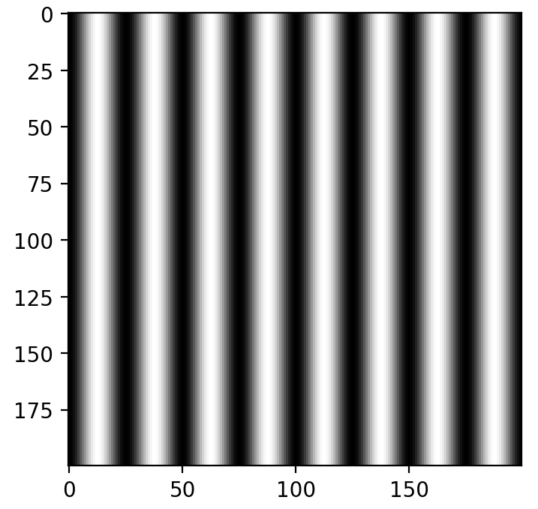
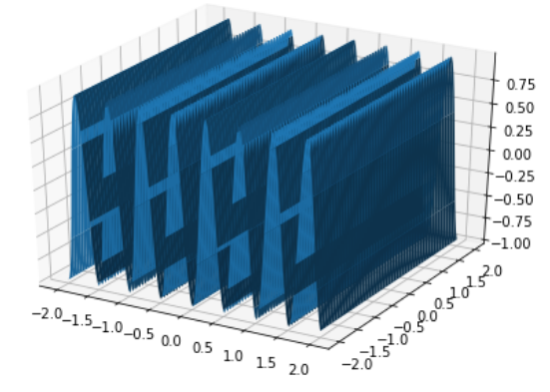
Results
a. Sine wave, f = 4 cycles/cm
Activity 1: Image DIY
Images are made in a 200x200 pixel meshgrid. The shapes and details are specified using 2d array functions. Viewing the 3d representation also allows for better visualization. These are done using code shown on the left.

Slide 5
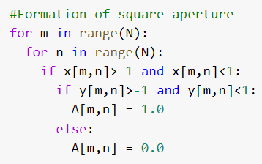
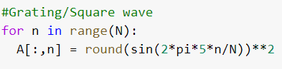
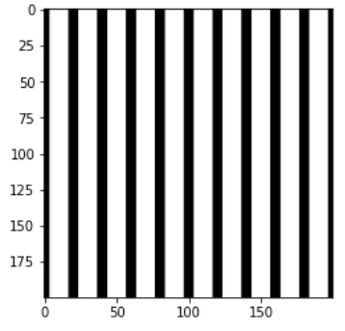
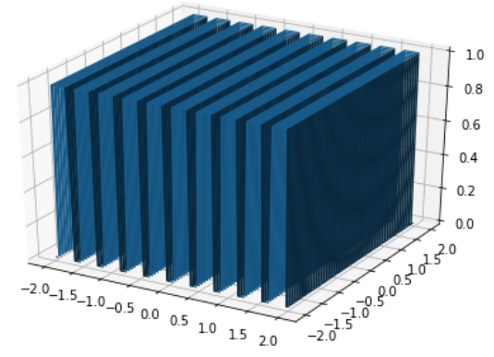
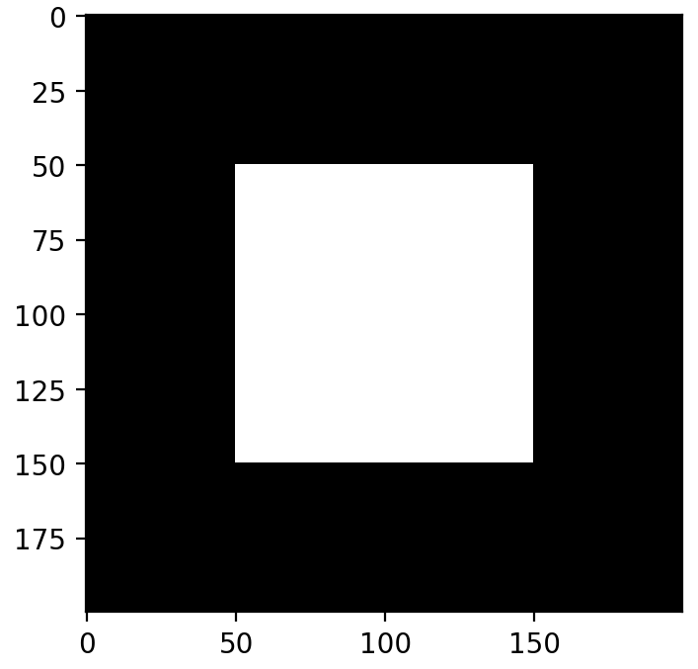
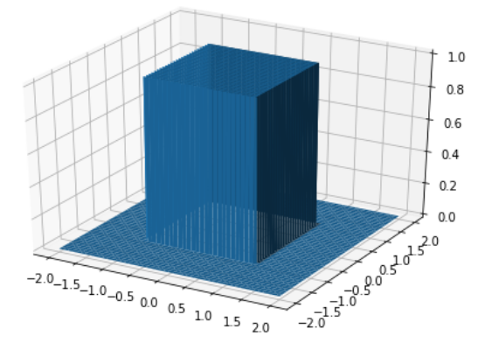
Images, their key code snippets and the corresponding 3d graphs
b. Grating/Square wave, f = 5 lines per cm
c. Square Aperture, 1x1 cm

Slide 6
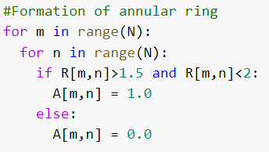
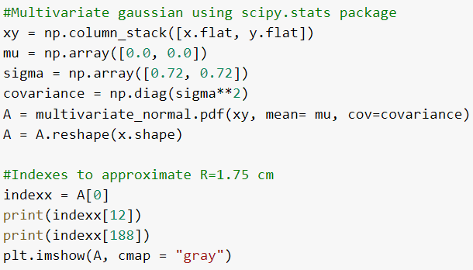
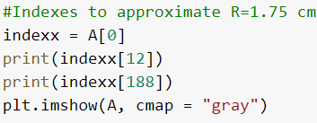
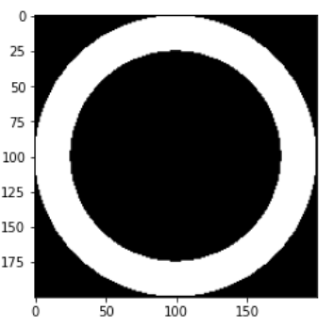
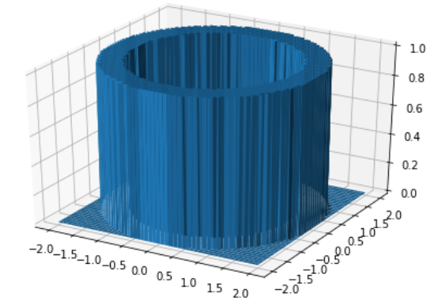
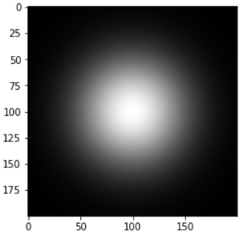
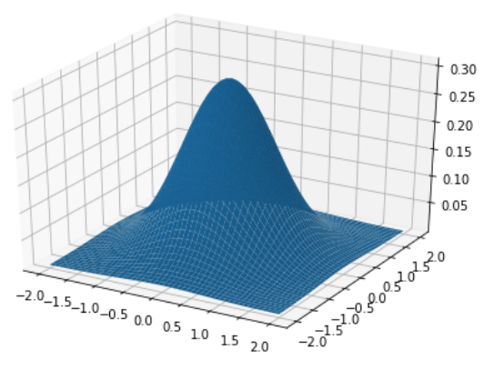
Images, their key code snippets and the corresponding 3d graphs
d. Annulus, R = 2cm, 0.25 cm thick
e. Circular gaussian aperture, R = 1.75 cm sigma = 0.72 cm

Slide 7
Analysis
The 3d visualizations are good ways to validate whether the desired shape/feature is achieved.
Parameters of the object were easy to set with the right setup, functions, and commands.
All images except the gaussian were made to fit specifications. I am simply unable to figure out how to configure it with sigma 1.0 cm, though I am aware that it is possible.

Slide 8
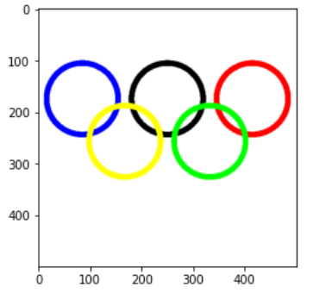
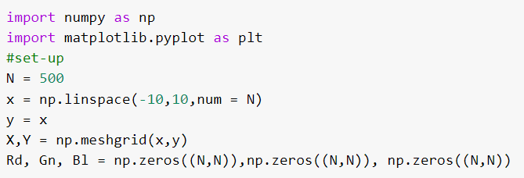
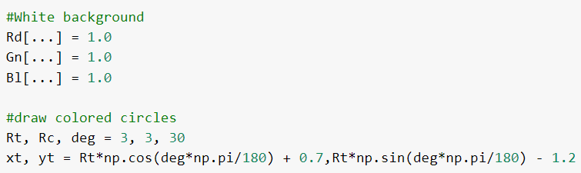
Results
In making the Olympics logo, there were three parts of code. The first part is the set-up, where the necessary space and arrays are made. Afterwards, I denoted the size of the colored circles using the general equations for a circle.
Activity 2: Color Image

Slide 9
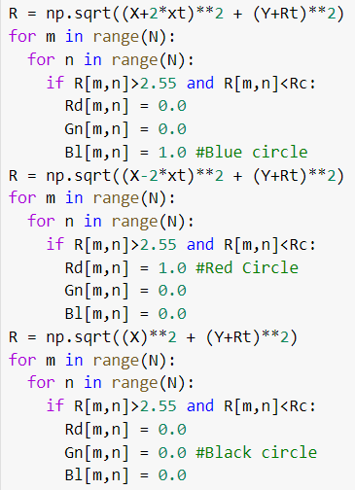
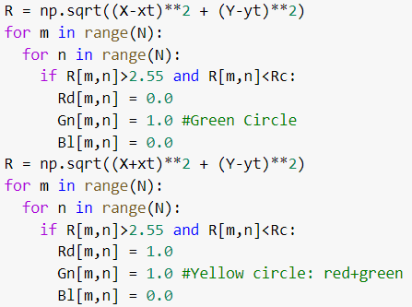
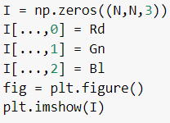
The last part was specifying the combination of colors (R,G,B) for the color needed at specific parts of the meshgrid/2d array.

Slide 10
Analysis
Color is specified in images using the third array indices from 0 to 2.
Each pixel is given a corresponding combination of colors, which is achieved by setting annular areas that can be given the specific combinations. The white background is made by giving the background a combination of all colors.
The command np.where is more efficient here for larger images, but I decided to use nested for loops to easily visualize the more general process.

Slide 11
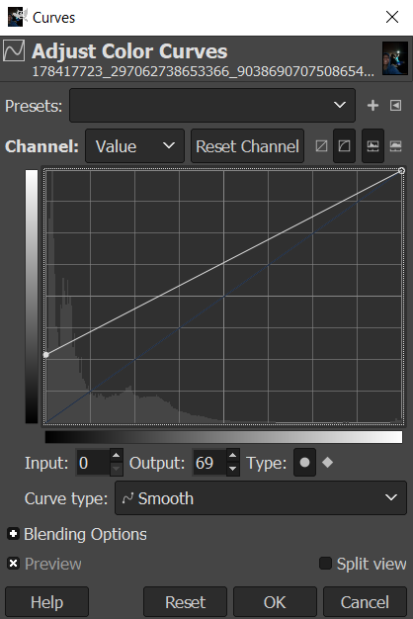
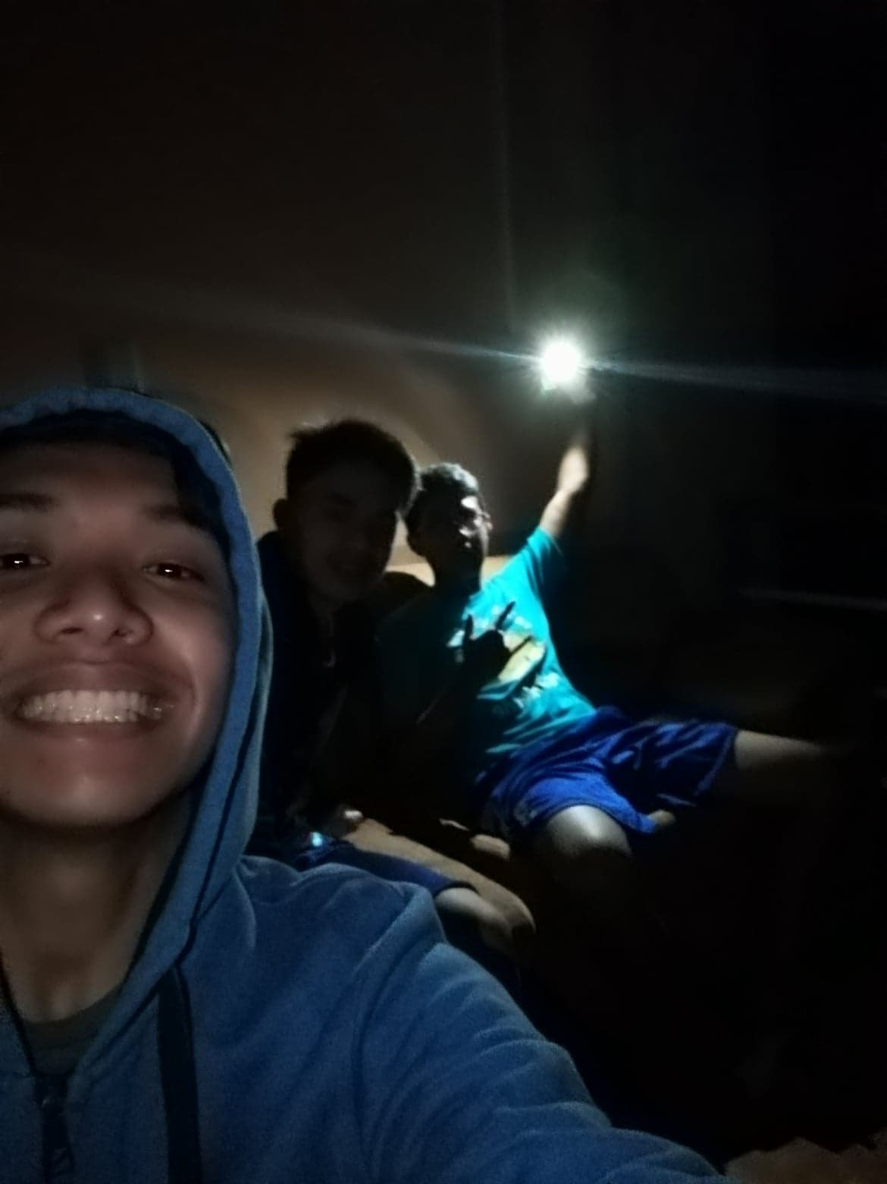
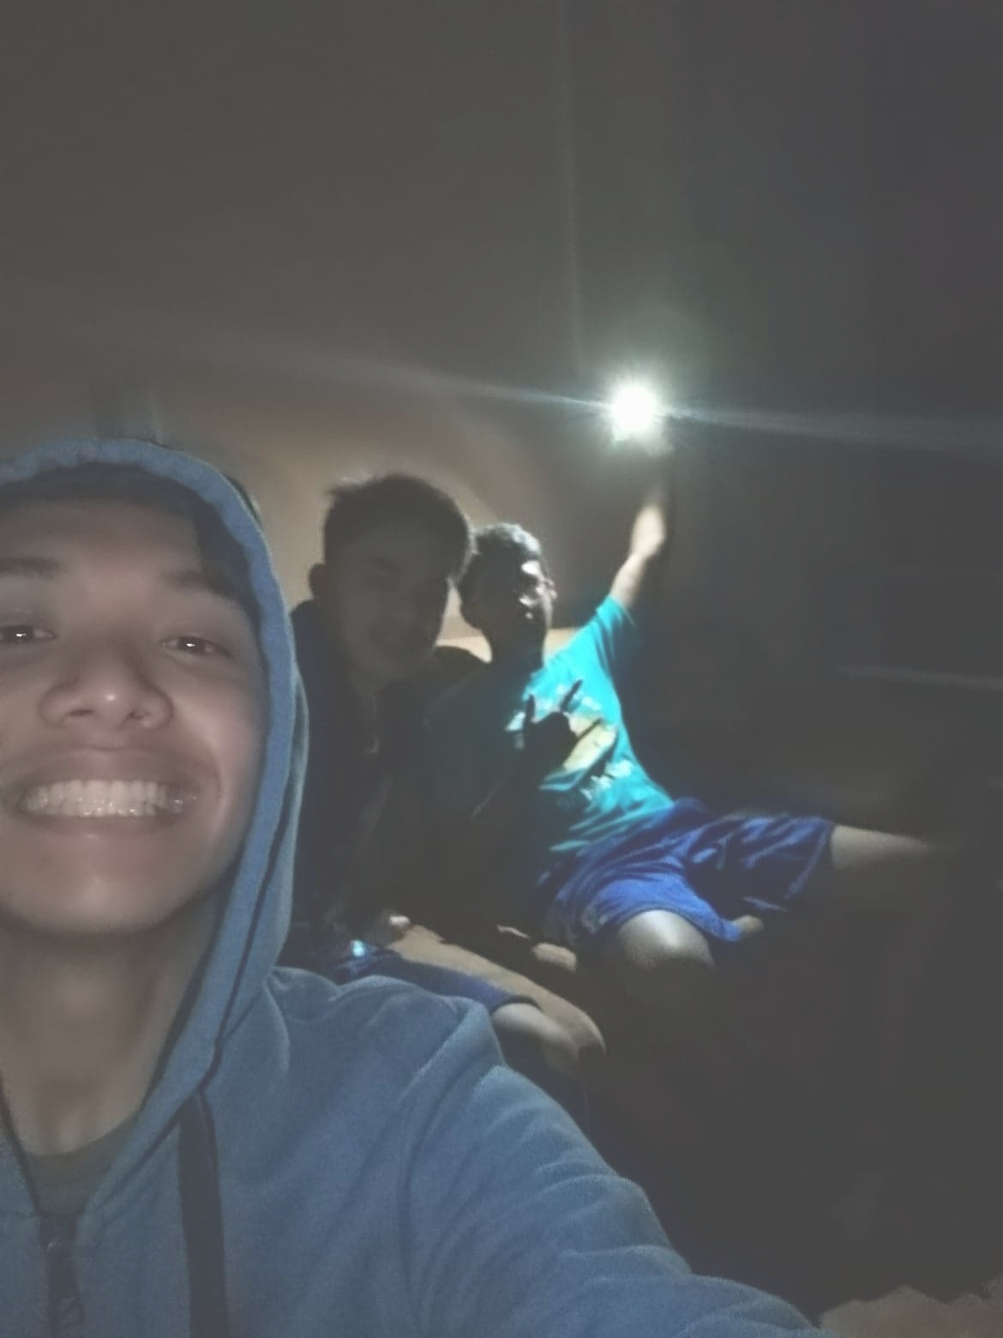
Results
I used a very dark picture me and my friends took back in high school. I found the most visible details when setting the input to 0, and output to 69.
Activity 3: Altering the I/O curve
Before In =0, Out =0
After In=0, Out=69

Slide 12
Analysis
Altering the input-output curve helps distribute the grayscale histogram more evenly. This gives the image better contrast, which makes details much easier to see.
The image I used had a histogram which was heavily skewed towards the darker graylevels or lower values. Keeping the input similar but the output at 69, I am effectively increasing the grayscale value of all pixels, making the image much brighter.

Slide 13
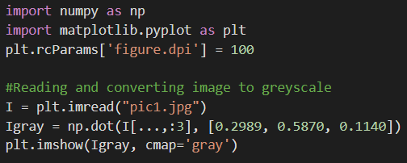
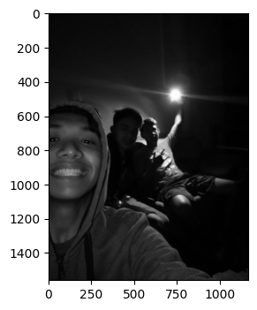
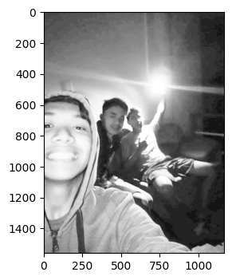
Results
Using the dark picture again, I read and convert the image to greyscale. Shown below is the result after enhancing via backprojection.
Activity 4: Histogram Backprojection on Grayscale Images
After
Before

Slide 14
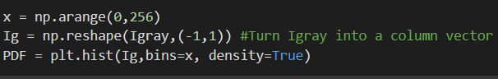
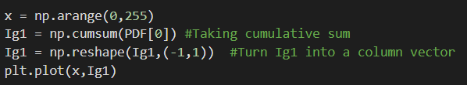
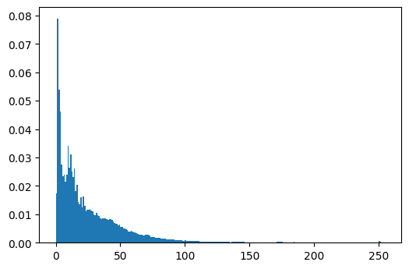
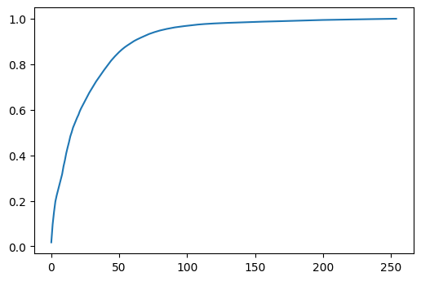
The first step was to take the PDF and CDF of the greyscale image.
PDF(Greyscale normalized probability distribution function)
CDF (Cumulative distribution function)

Slide 15
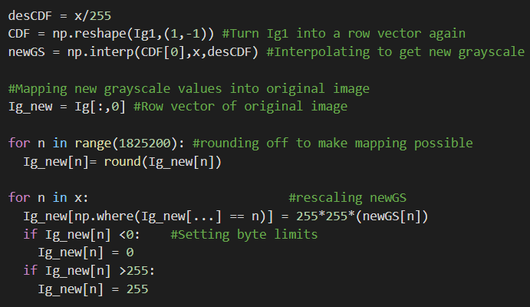
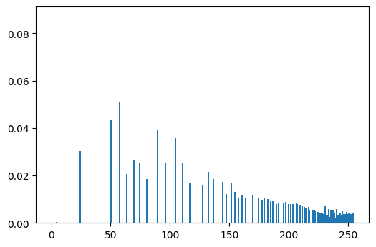
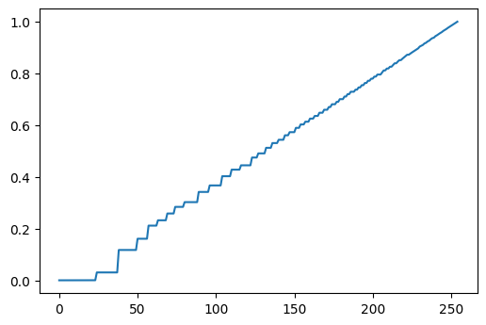
Afterwards, we interpolate the old CDF with the desired one, desCDF. We can then adjust each pixel in the original image using the new greyscale, newGS.
We then end up with the enhanced image, with the corresponding new PDF and CDF shown below.
New PDF
New CDF

Slide 16
Analysis
Similar to altering the input-output curve, we improve the contrast of the image by spreading out the grayscale histogram. We make it more centered instead of left-skewed.
Looking at the CDFs, the new CDF is much more linear and gradual in its increase. Left-skewed and right-skewed CDFs follow more exponential/drastic increases along the initial or final values of the CDF respectively.
The process is straightforward, but several pitfalls can be found such as the re-scaling of the final image, the setting of byte limits, and understanding how to use the acquired newGS.

Slide 17
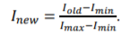
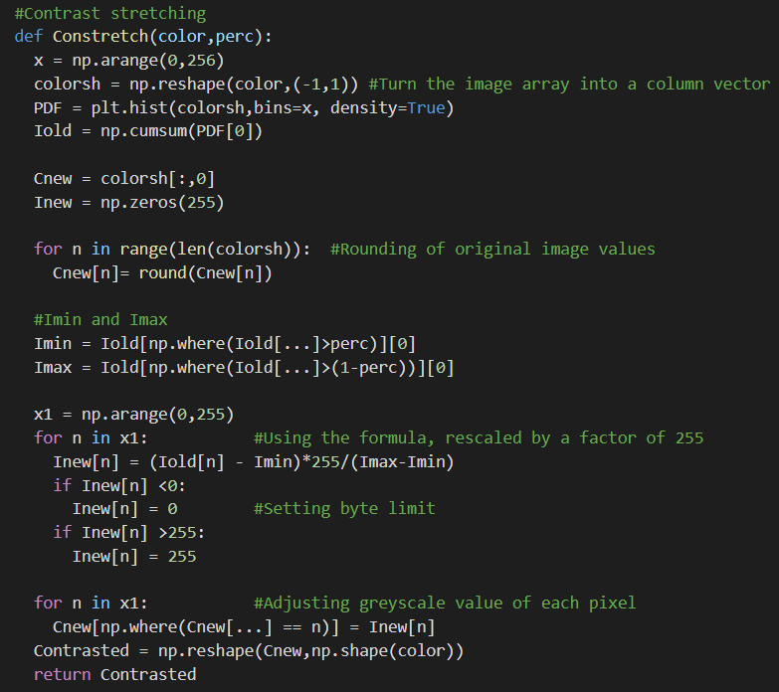
Results
For contrast stretching, we take the PDF and CDF of the greyscale image and use the formula to adjust each pixel in the image.
Activity 5: Contrast Enhancement

Slide 18
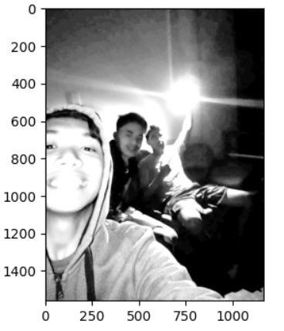
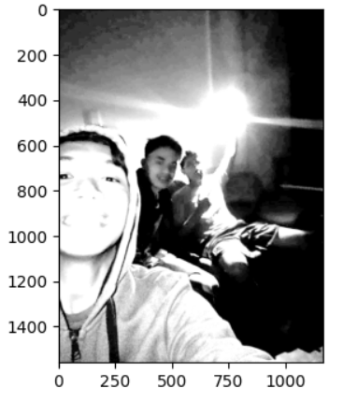
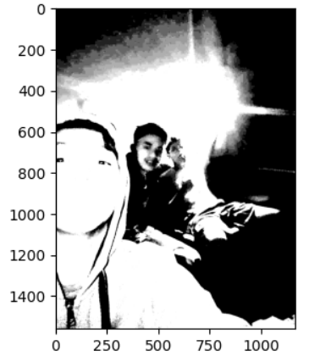
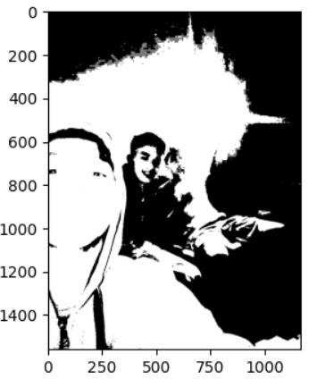
At a low percentile limit, the image appears well enhanced. As we increase the percentile, detail is lost, and the image is contrast stretched to a high extent.
Imin = CDF at 0.1 Imax = CDF at 0.9
Imin = CDF at 0.2 Imax = CDF at 0.8
Imin = CDF at 0.4 Imax = CDF at 0.6
Imin = CDF at 0.48 Imax = CDF at 0.52

Slide 19
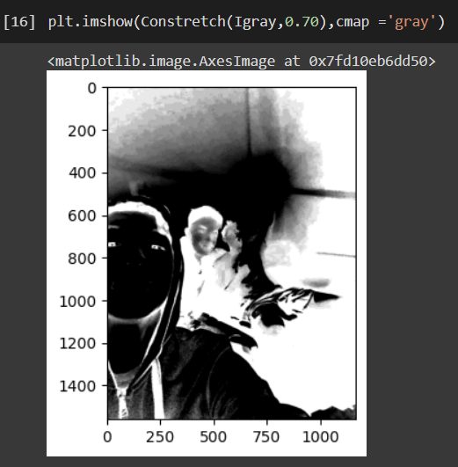
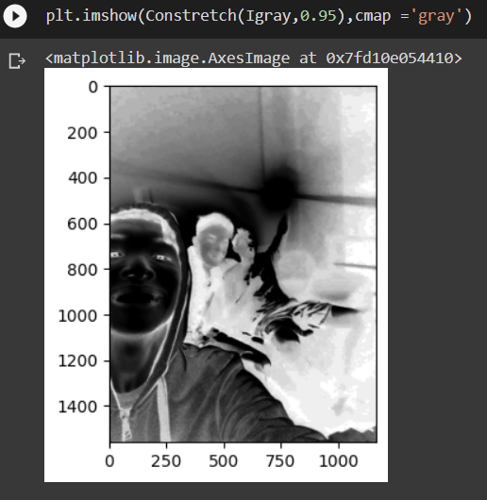
Additionally, going past the 50th percentile for Imin essentially takes the negative of the image.

Slide 20
Like the last two activities, this method uses a more straightforward formula to acquire the newGS, in the form of Inew.
Using the formula spreads out the greyscale values of the image, making it more centered and better contrasted. Increasing the percentile closer to 50% also forces most of the values to 0 and 255, which results in images losing detail and becoming more black and white.
Analysis

Slide 21
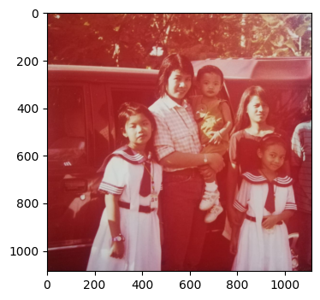
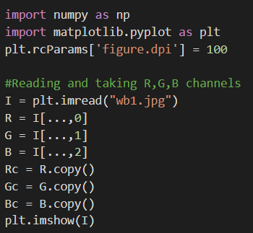
Results
The image I am using is an old image with a red cast.
Activity 6: Restoring Faded Colored images

Slide 22
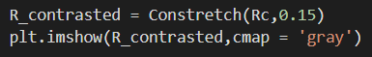
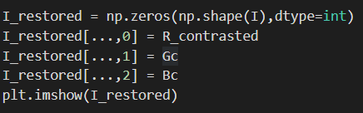
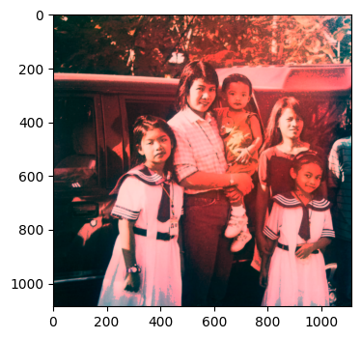
a. RGB Contrast stretching
Since most of the imbalance was red, I only contrast stretched the red channel. Contrasting the blue and green channels often led to bad results. Most of the red cast was removed, but still remains around the center.
Before
After

Slide 23
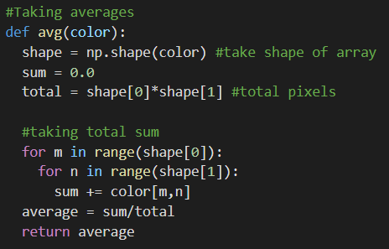
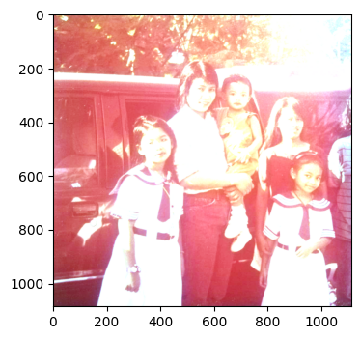

b. Gray world algorithm
Before
After

Slide 24


c. White patch algorithm
The white patch I used was a rectangular area of their uniform, specified by the array indices in the code.
Before
After

Slide 25
Analysis
For the first method, most of the red cast was removed by lessening the red intensity of some red. Since I didn’t adjust the green and blue channels, the picture also became darker as a result of general contrast stretching. Too many details were lost having all channels contrast stretched, which is why I opted to do it this way.
For the next two methods, both led to a brighter image. Both operate through averages, and the corresponding protocols and results make sense. The gray world algorithm uses a more general and weighted average, keeping the picture clear whilst white-balancing some areas. The white patch algorithm uses a more extreme sample, taking a patch of known deviation, and applying its average all throughout. This leads to a more balanced, but less clear/consistent image.

Slide 26
Self-Reflection
The first activity was tedious, since I had to refresh on coding, and since I was a bit confused by the dimensions. I believe my results are valid/correct for all images except the gaussian, which I am unable to fit within the specified dimensions.
The Olympic logo activity helped me understand how color was represented in python, and this helped a lot in the next activities. The third and fourth activity were similar, but 1.3 was much more straightforward. I had trouble in 1.4 on how to use the array acquired from interpolation, and this actually took me about 2 weeks to figure out. It made sense how all I needed to do after was replace the grayscale values of the original image. I also had to re-scale everything so that the values were from 0 to 255. I realized this when the new PDF and CDF looked weird.

Slide 27
Self-Reflection
I opted not to experiment with different desired CDF (desCDF) shapes since at the time of coding, I was very much swamped with other responsibilities, which is partly why I deducted my self-grade on technical correctness.
The contrast stretching and white balancing activities taught me that I should limit my data from 0 to 255, and that I should rescale it as necessary. I initially took a while with defining my Constretch function since I had not fully grasped the concepts beforehand. I ended up with expected results in 1.5, and somewhat expected results in 1.6. I am not fully confident with my results in 1.6a, since every time I contrast stretched the blue and green channels, the resulting image would be worse than the original. This is also a reason why I deducted points on technical correctness.

Slide 28
For the latter part of the activity (1.4-1.6) I consulted with my classmate Earl and we were able to compare and cross validate results/ideas. He helped me out of the slump I encountered in 1.4. He gave good insight on how the new grayscale values should be applied to enhance the dark image. I was very happy when it worked since I had ben stuck for a week there. Additionally, I got the idea of re-scaling to [0,255] from the sample code you included for white-balancing.
Self-Reflection

Slide 29
Self-grade
Technical correctness: 28/33.3
I could use work on the understanding of contrast stretching and white balancing
Presentation quality: 33/33.3
1
I tried my best to make a concise and aesthetically pleasing presentation.
2
Self reflection: 33.3/33.3
I strive to be transparent and honest with how I think I did in this activity.
3

